Slide 1
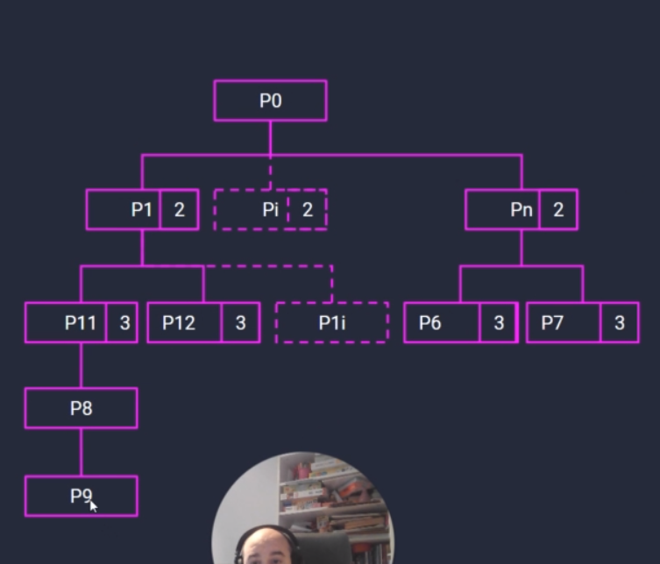
Database Design
Since this is a hierarchical data, so the database can be modeled as an Adjacency List. The adjacency list (self relational) pattern is a common relational pattern whereby a table contains a foreign key reference to itself,
It’s achieved by storing the ID of the related record on the desired record. You add one column to your table, and set it as a foreign key to the same table’s primary key.
Bike--+---> Seats
+---> Wheels--+--> Tube
| +--> Frame
+---> Pedals
Column Type | Data Type | Allow Types
ID | int | Unchecked
NAME | nvarchar(MAX) | Checked
PARENTID | int | Checked
BUNDLEID | int | Unchecked
ID | NAME | PARENTID | BUNDLEID
109 | Bike | NULL | 4272
110 | Seat | 109 | 4272
111 | Pedals | 109 | 4272
112 | Wheels | 109 | 4272
113 | Frame | 112 | 4272
114 | Tube | 112 | 4272
115 | Bike | NULL | 3822
116 | Seat | 115 | 3822
117 | Pedals | 115 | 3822
118 | Wheels | 115 | 3822
119 | Frame | 118 | 3822
120 | Tube | 118 | 3822
121 | Bike | NULL | 3873
122 | Seat | 121 | 3873
123 | Pedals | 121 | 3873
124 | Wheels | 121 | 3873
125 | Frame | 124 | 3873
126 | Tube | 124 | 3873

